Slide 1
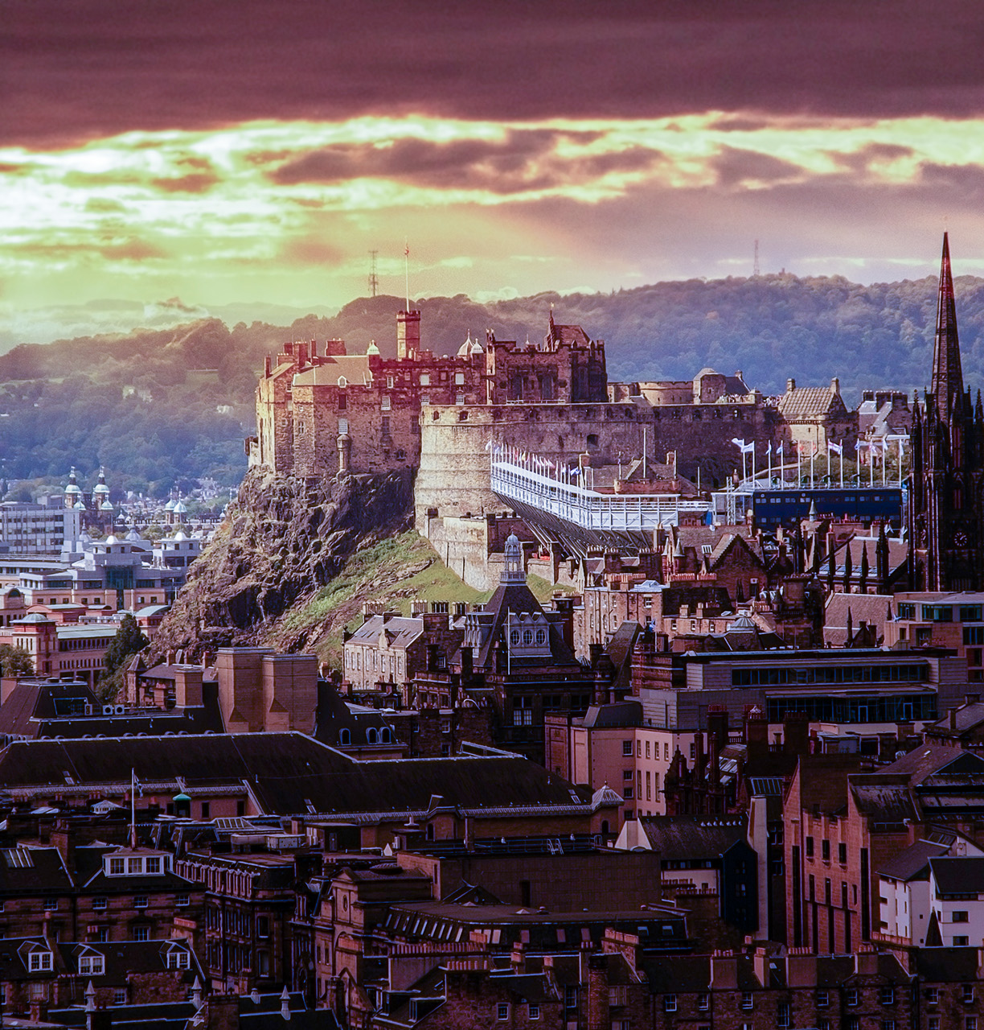
Doyle-Russel developments
Thistle Street Website
Jack Doyle

Slide 2
Understanding the Project
Our Objectives

Slide 3
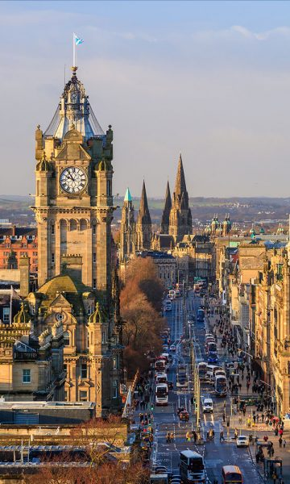




WEBSITE OBJECTIVES
Increase Awareness of the project
Increase Contributions
Expand the project

Slide 4
Audience Research
The Ultra Affluents

Slide 5
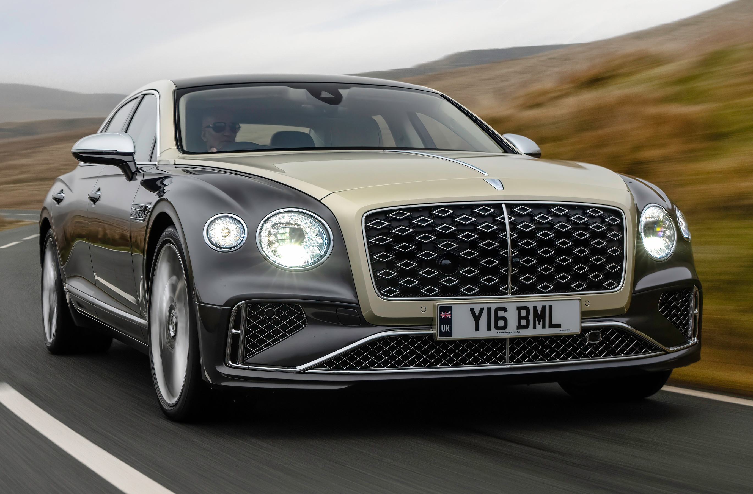
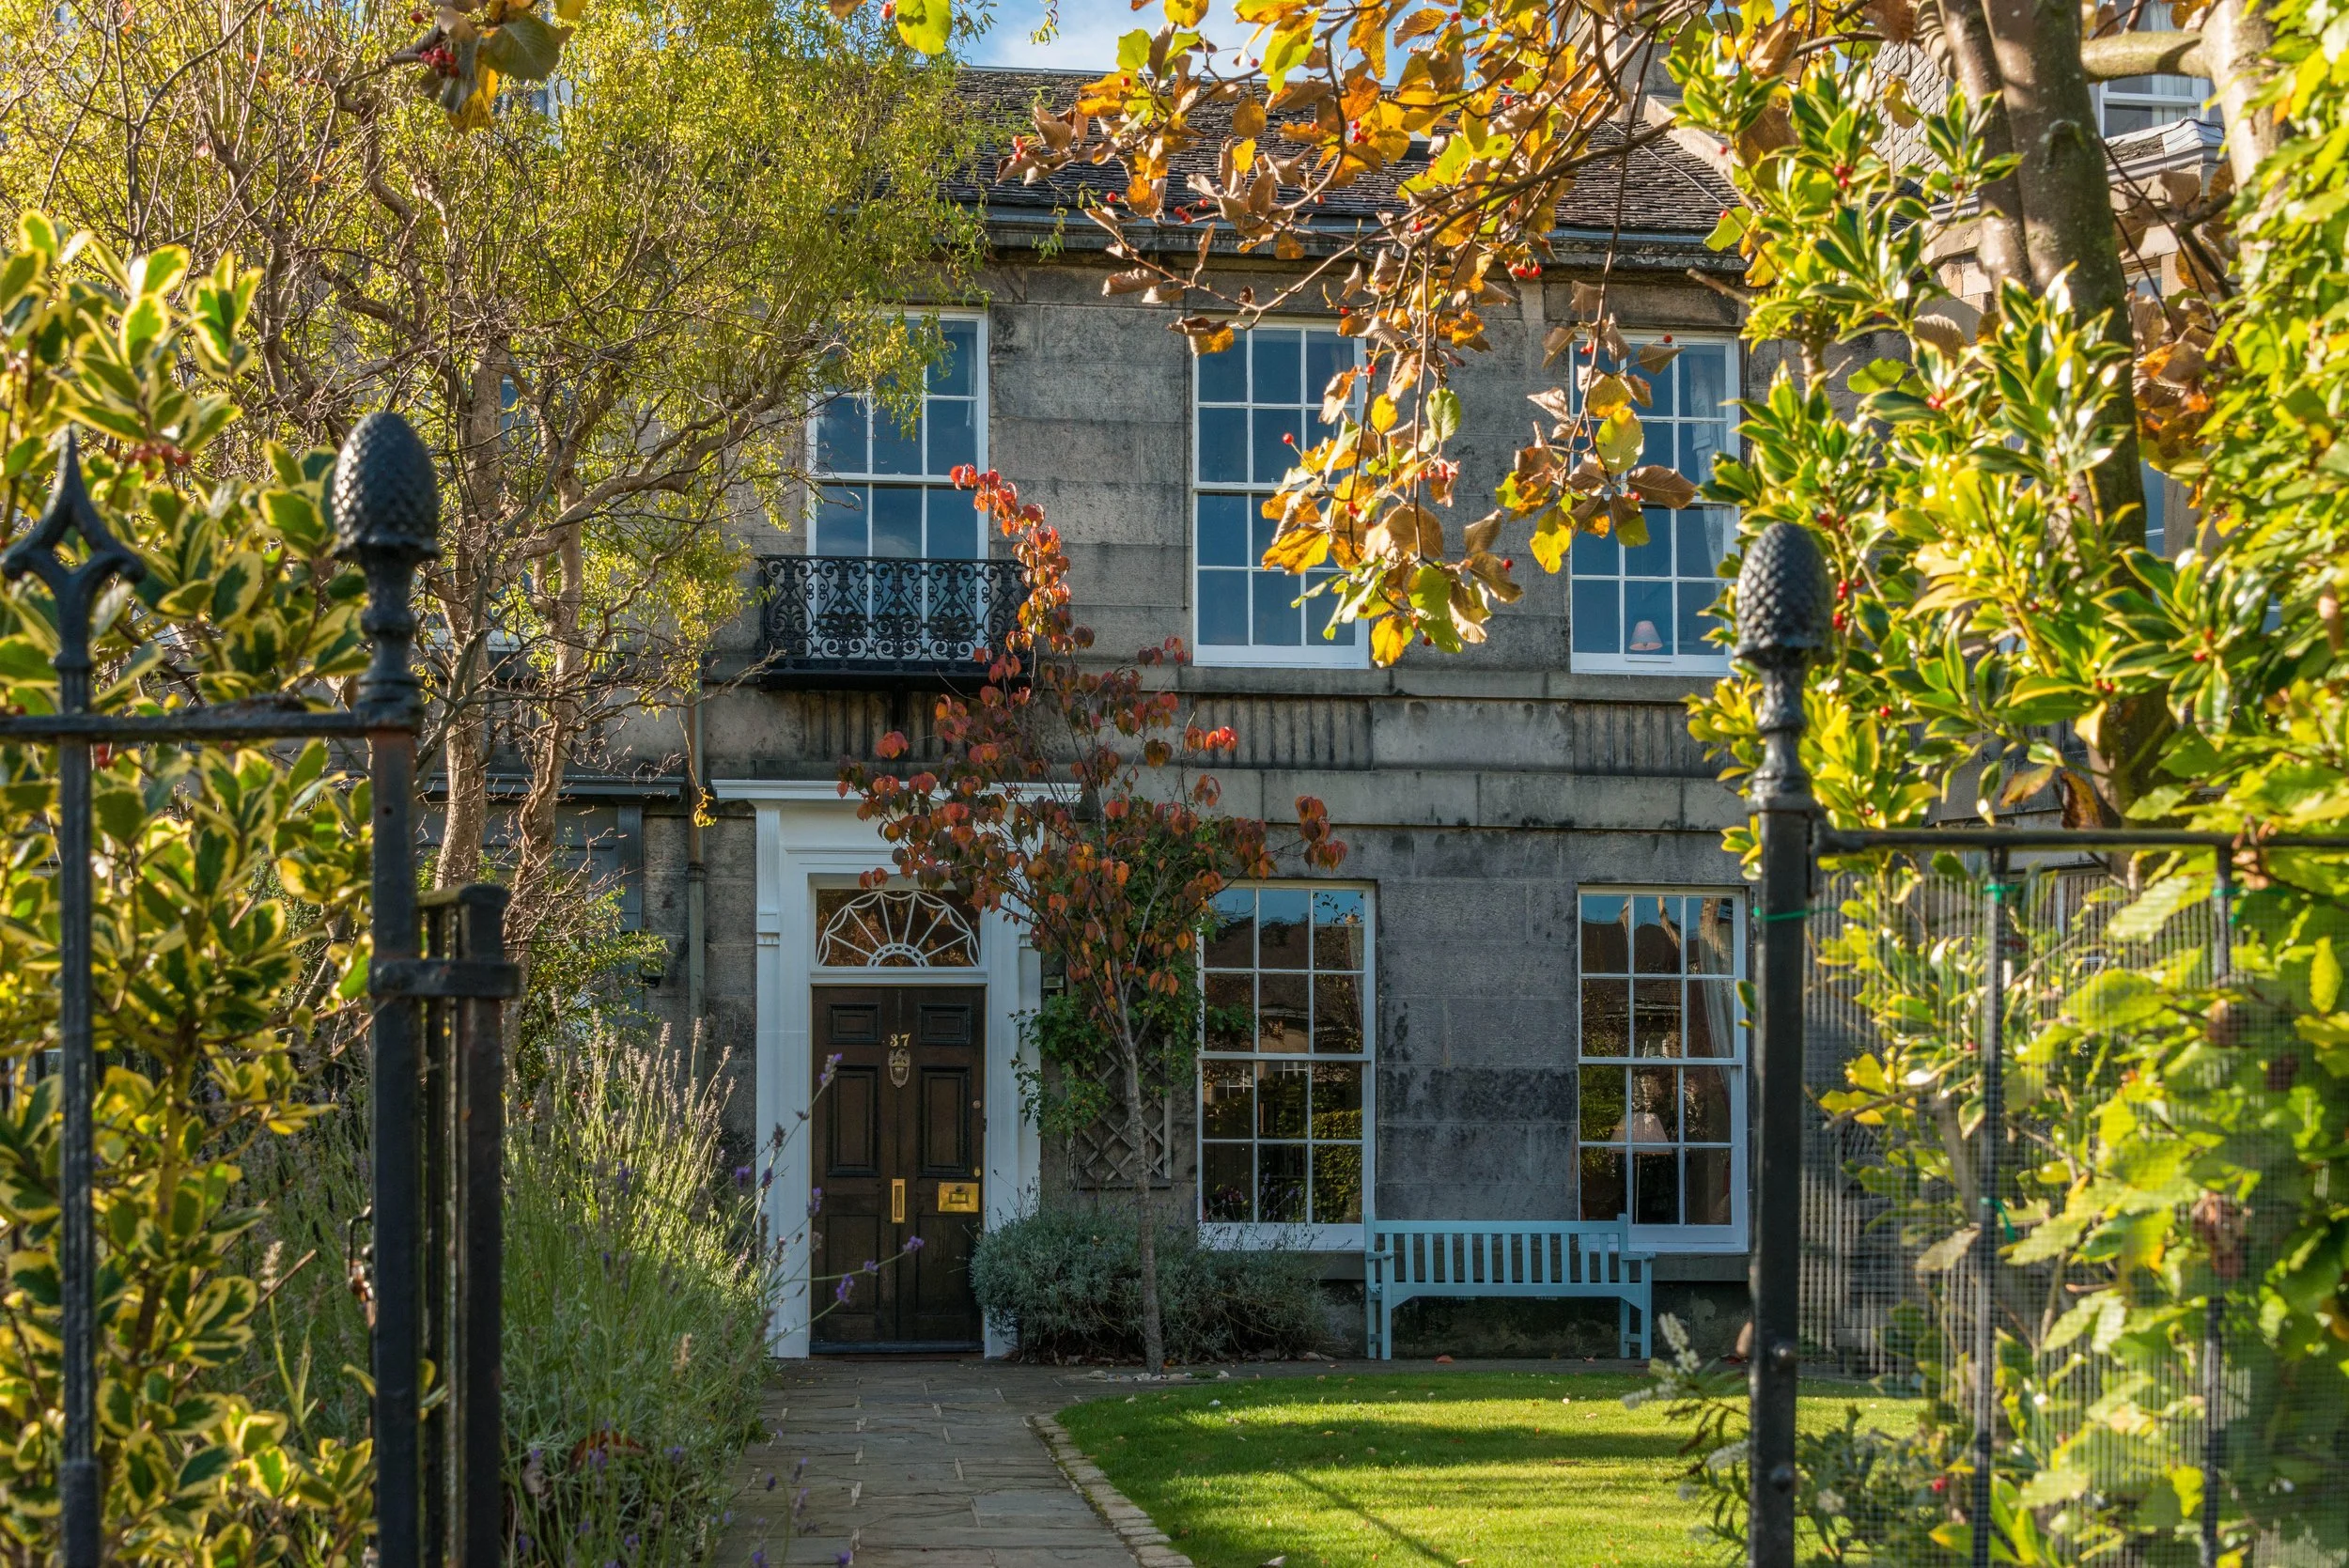
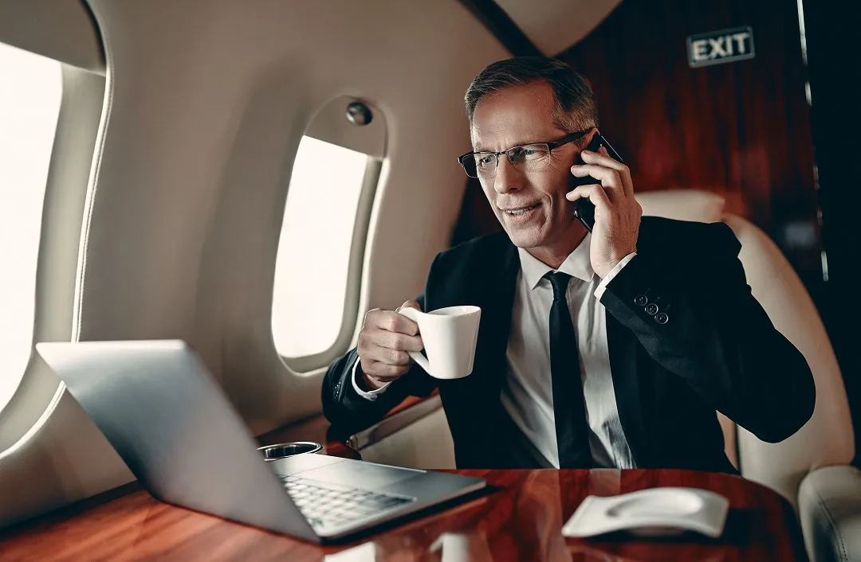
What are the top 1% like?
The top 1% are semi-retired, Oxbridge-educated professionals aged 45–60.
They live in gated communities, value freedom, legacy, privacy, and exclusivity, and prefer discreet wealth.
Lifestyle includes golf, tennis, art collecting, premium travel, and wellness.
Risk-calculated early adopters, they seek diversification and expect a premium, personal investment relationship

Slide 6

Lifestyle Items of the Ultra Affluents

Slide 7
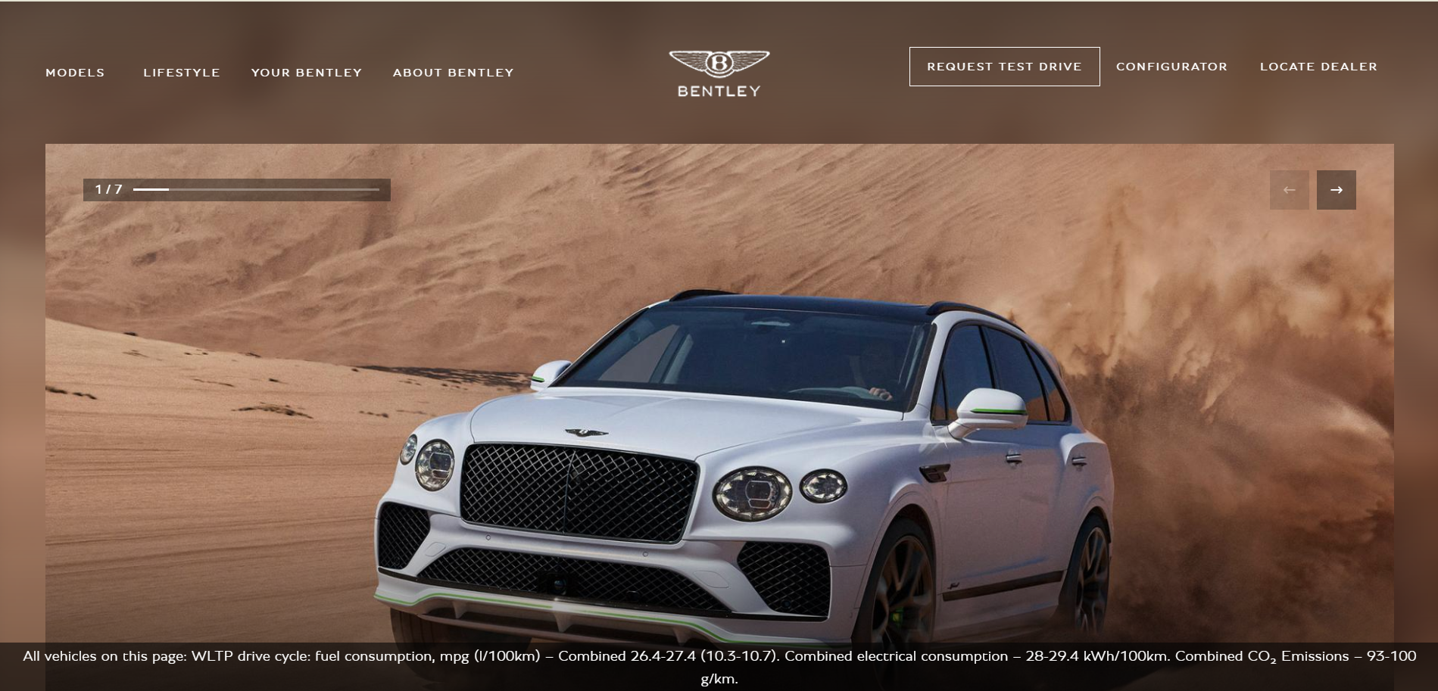
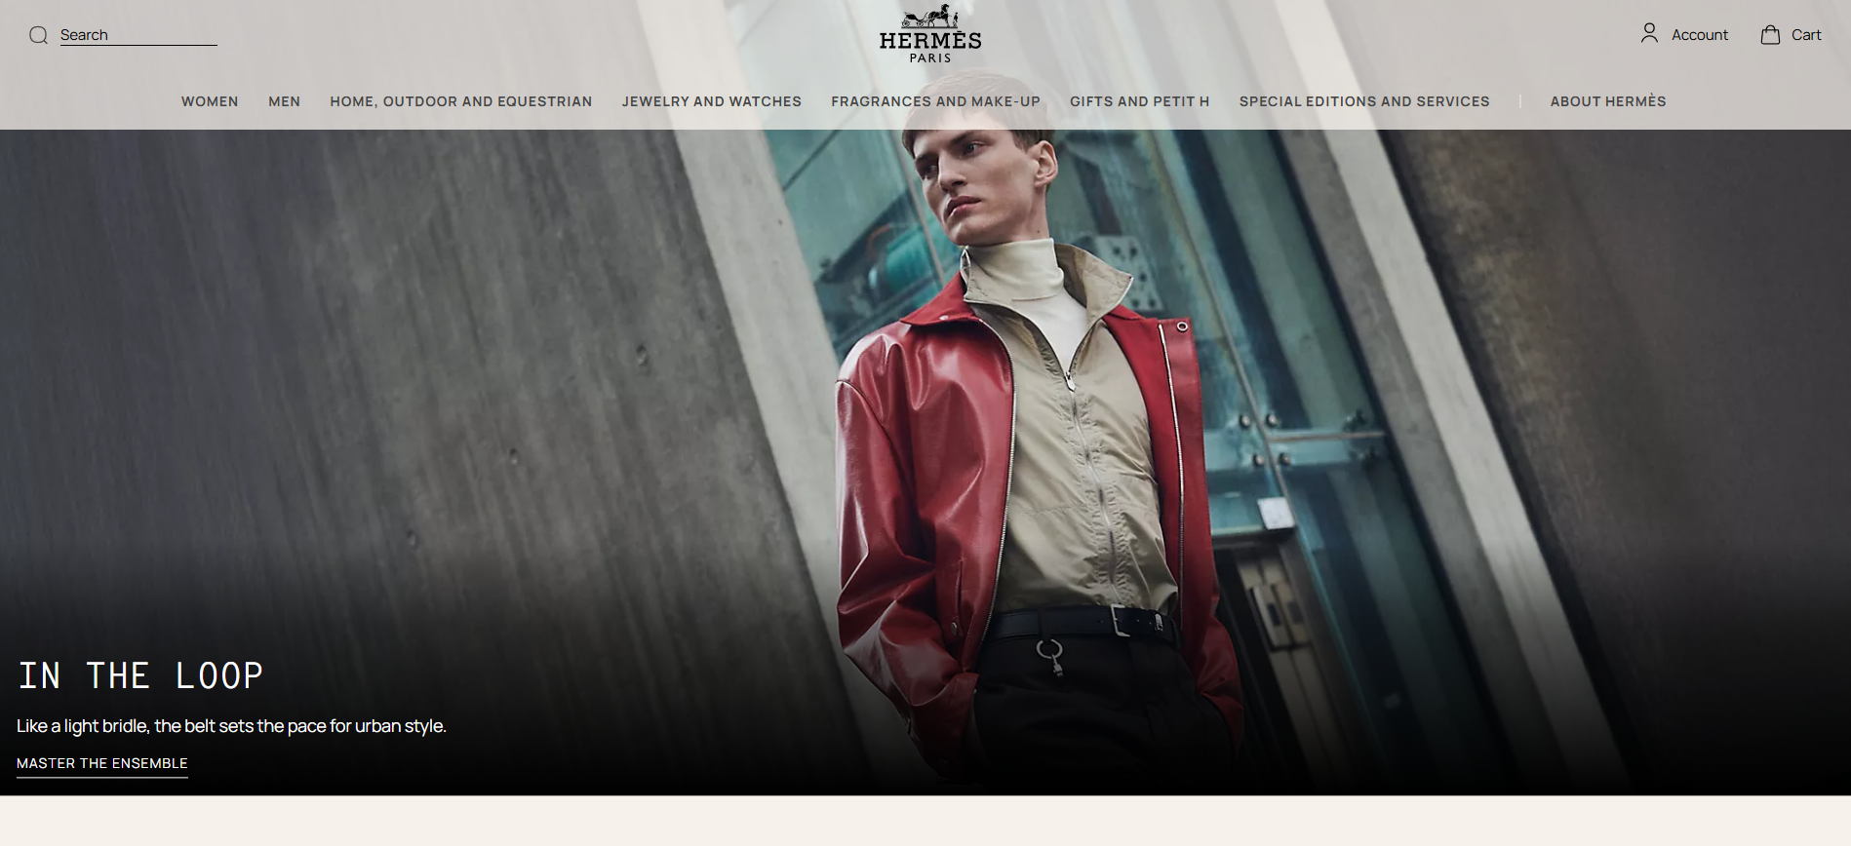
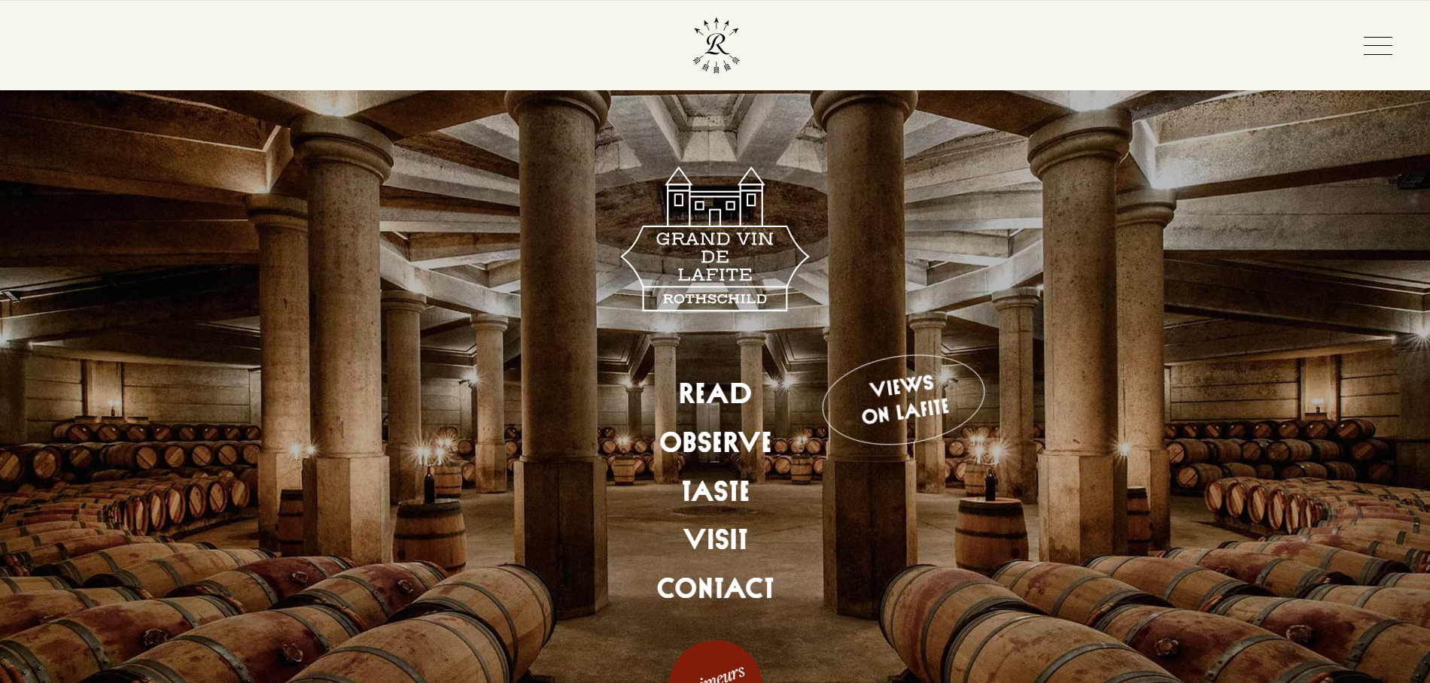
Familiar websites
How this helps our idea
As we see these websites represent that discreet luxury, using minimalist and soft colors to display that. This should be an idea we use in our website.

Slide 8
Most consumed media channels of the Ultra Affluents

Slide 9

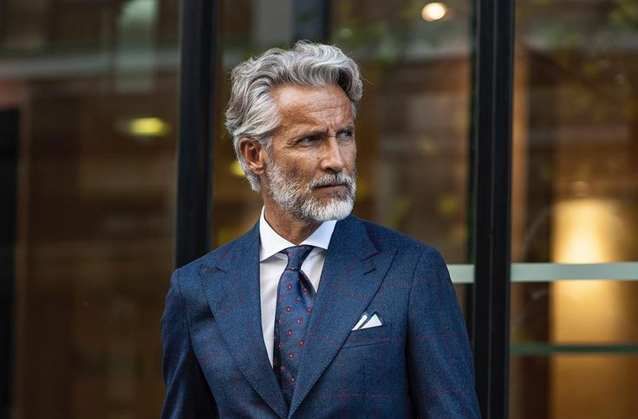
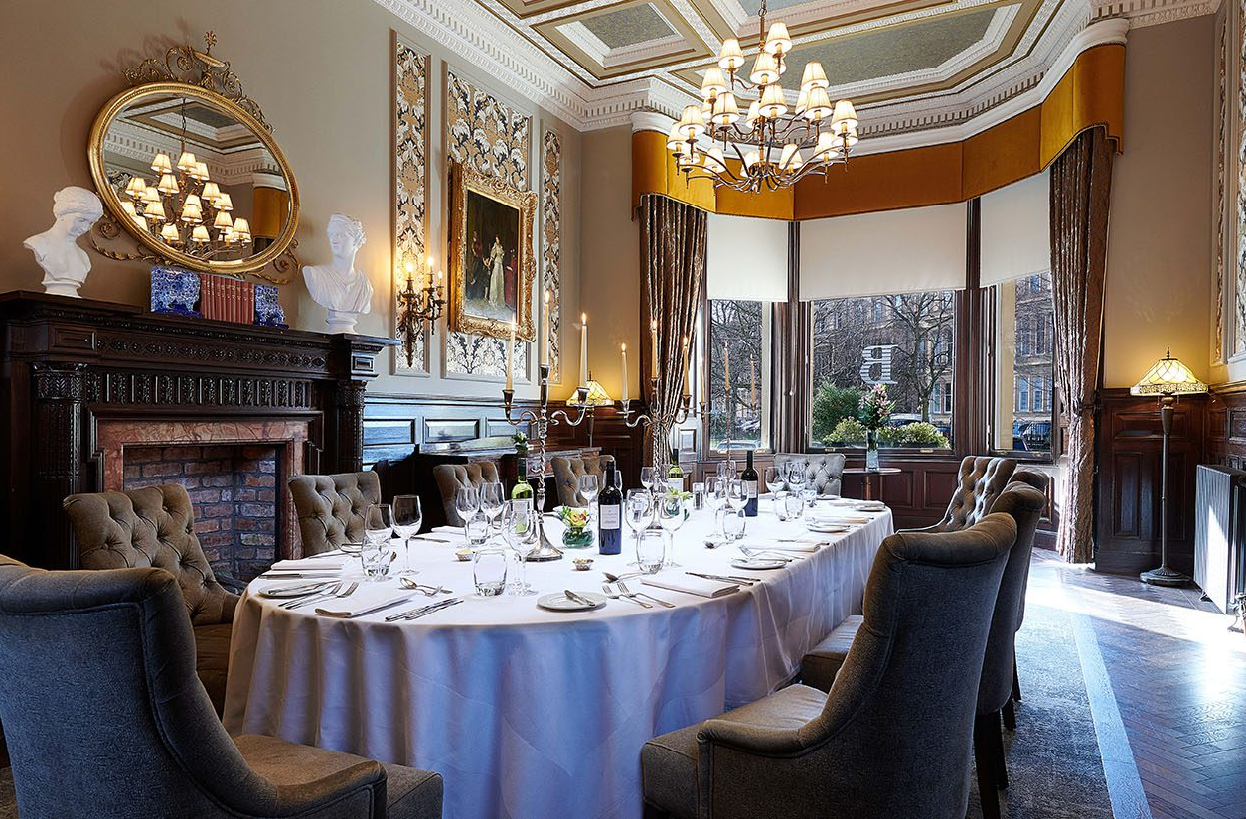
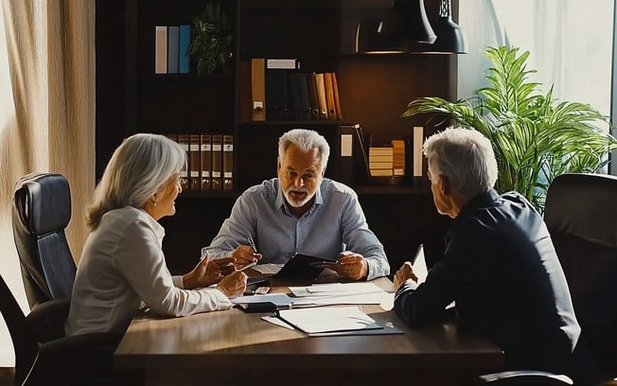
How the audience move their money
The ultra affluents net worth generally ranges between £5m – £25m (including assets).
Their income normally comes from business profits, salary or equity, annually making between £200k - £2m+.
Most common jobs are CEO, entrepreneur or family office beneficiary.
They are open to early investments but like exclusivity, tending to make multiple investments a year

Slide 10
How do the ultra-affluent allocate their investments?
How This Helps Us
This is from 2024, Recent data shows that 44% of family offices are allocating more towards real estate.
This is a big signal that the market is in big demand, possibly because of the cutdown on Airbnb's forcing property to go on sale.
This is good for us as we know there is more interest than ever in things like our project.

Slide 11
Competitor review
Website Intel

Slide 12

Most Airbnb's owned by a single account
123
Listings
65
61
Listings
Listings

Slide 13
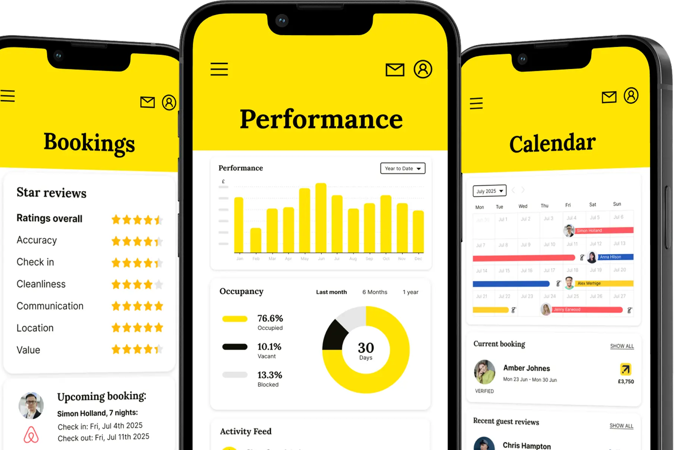
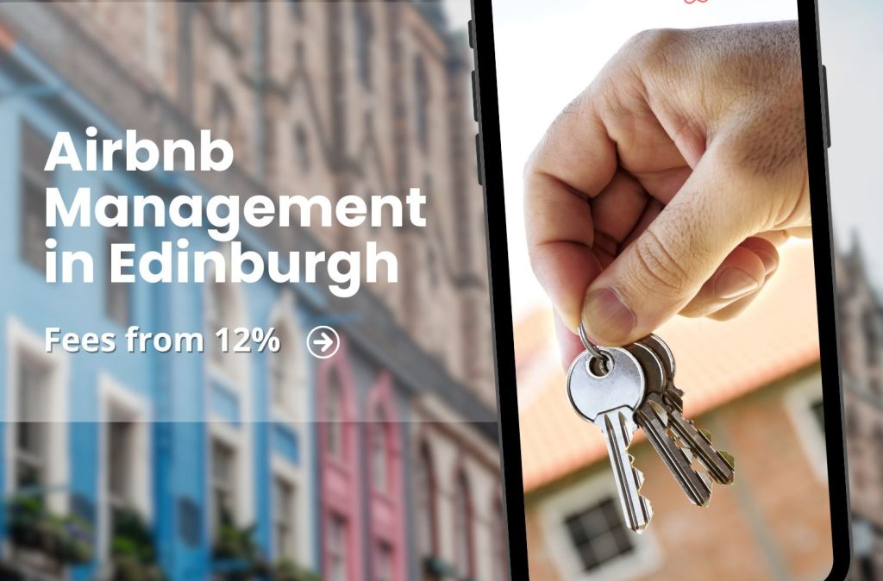
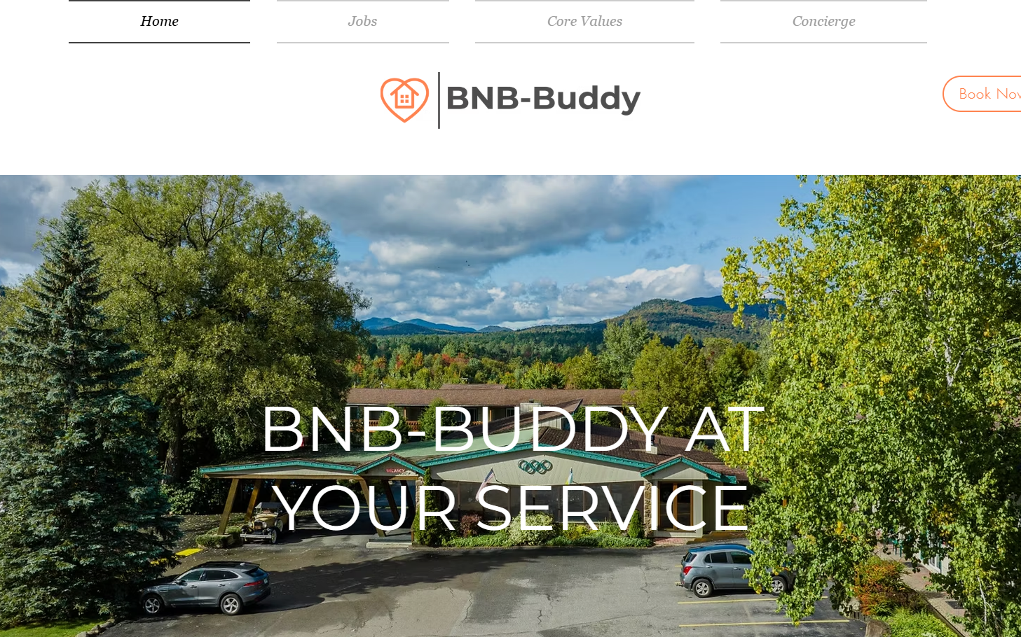
What are BnBBuddy up to?
As we know they have 123 listings on Airbnb; none of these they actually own or lease. yet their making £7.1.m a year of doing it for other people. How do they find these people?
For one thing they do google and Facebook ads, specifically on people searching how to make money from Airbnb.
Though, 40% of their business comes from referrals and word of mouth. 40%! And they get referrals from none other than clients of their accountants.
They also get 10% of their business from seasonal pitches, telling people while their out for august the empty house could make £10K.

Slide 14
Where do BnBBuddy get their investors from?
How This Helps Us
40% of their business comes from referrals alone, mainly customers of their accountants.
This means just knowing people like accountants, stockbrokers and anyone who deals with our ultra-affluent audience for their job could turn into your advertising banners.

Slide 15
Where do BnBBuddy get their investors from?
How This Helps Us
This shows us how important getting through to our audience on socials and website is.
They don’t even do their best on socials, having no more than 200 followers on each platform.

Slide 16




What can we learn from BnBBuddy?
Seasonal pitches
Referrals
Social media
Website
Tell the potential investors the money that can be made in just august
Post engaging media about our plans on platforms our audience are on
Leave business cards or make good connections with your accountants, lawyers, anyone who handles our audience on a daily basis
Make a slick website that is user friendly and aesthetically pleasing to the eye

Slide 17




Competitors weakness
What we can take from it
2
1
3
Social
Brand image
Their brand image is bad simply because they don’t have one. Website is bland and without purpose, posts are not engaging, ads are dry at best. They spend so much yet produce so little
Large audience
BnBBuddy try and entice the not so rich to join them. They go for more broad advertising instead of targeting our ultra affluents directly.
Print media
Most of their money comes from referrals or trusted sources. If you remember, magazines are the highest consumed media by our audience, yet BnBBuddy are going no where near it and focusing on socials.

Slide 18
The Gameplan
Where the fun begins

Slide 19
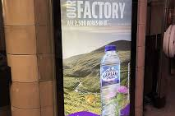
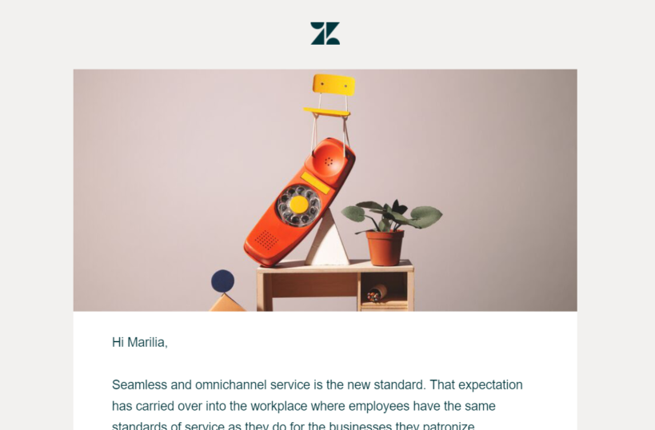
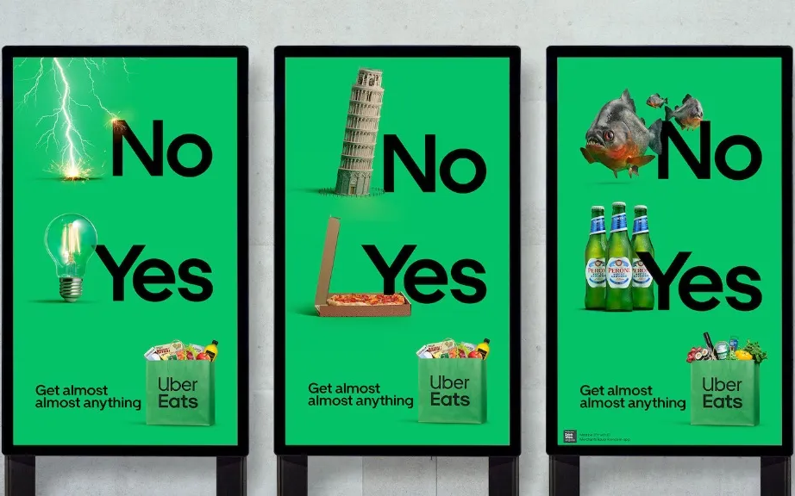
We need to be a bit creative
So, here’s the situation; We’re trying to bring in hundreds of thousands (possibly millions) of pounds with a very limited budget. For example, BnBBuddy spend £100,000+ every year on advertising.
But I like being creative, and there are ways we could do this. We just need to be honest about what we can’t do.
No google ads, magazine placements, programmatic, or any massive print campaign.
We’ve got our brains, buddy’s and manners to get us there. And I’ve got some good ideas.

Slide 20
The Gameplan
Why we should do a website

Slide 21
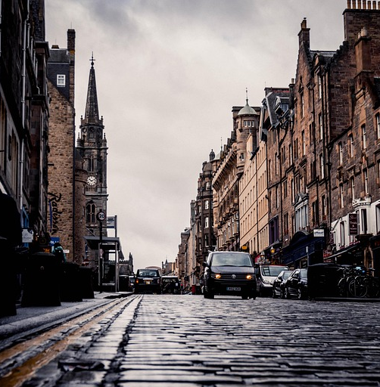
Why do a website?
Brand Image: One thing that will set us apart from investors is how we look. If we do a website, we want to do it well enough through tone, colours and layout to communicate who we are as a business. We don’t want to be soulless.
Platform: Think of a website as our virtual office, this is primarily where investors will come to sus us out. If we don’t have one, how are they to trust us? Who trusts a business with their money if they can’t show who they are.
Expenses: This is one of the most effective things any business could do, and it’s cheap.
We all know what a website is, and we know how good it can be. That’s if we do it right. Let's look at some ideas I have about how we can make this the best portfolio website in Scotland for investors to navigate.

Slide 22
How I’d like this website to look
My Ideas
Major colours
Although the most important thing about this website is going to be the functionality, I find it important that it looks pretty to. Especially for our brand image.
I liked the way I designed the presentation, so I want to follow a similar theme for the website, and I’ll explain why.
Purple is a very Scottish color I feel, It also represents quality, luxury and richness. That’s why Cadbury use it, and I think it’s useful for us
White is a base color, I like it.
Grey is also a modern felling color when used right.
Orange is the color of excitement, I think it’s important to not have a total corporate feel and have our brand have some life.
Light blue is a very trusting color, of course I is important to have the investor feel they can be safe.
Minor colours

Slide 23
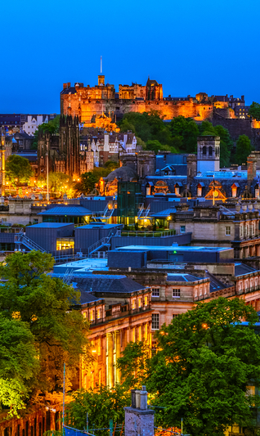



Tone of voice
(Copywriting)
Peer to peer
Tone of voice is everything when making an ad for brand image, even more so for a website. As an example, my work experience website wasn’t all that good, but the personality I put in the words absolutely made it stand out.
We don’t want to be salesy; this will imply distrust. Instead, we should talk peer to peer, like likeminded individuals.
We want to be bespoke, private and exclusive. “This isn’t for everyone, and we wouldn’t want it to be.”
We want to be legacy, and freedom focused. These aren’t these people’s way to millions; they’ve been there and done that. This is wealth preservation.
And, of course add a little confident spark. It’s important we stand out than blend in.
More of an invitation than offer
Not get-rich-quick. It’s an investment

